Slide 1
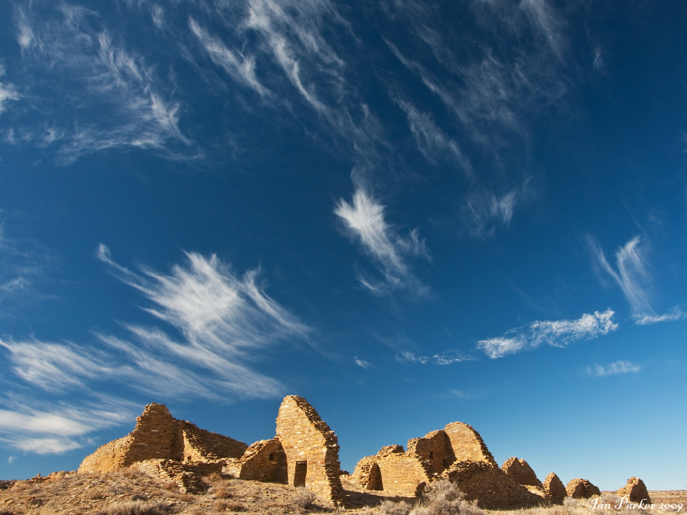
The Sun Dagger
Ajanta Barua
November 17, 2011

Slide 2
Anasazi

